Slide 1

Ahsanullah University of Science and Technology
Department of Computer Science and Engineering
Course No. : CSE 4250
Course Title : Project and Thesis - II
Automatic Text Summarization using Advanced Sentence Ranking Schemes

Slide 2
Supervisor : Mr. Mohammad Moinul Hoque
Associate Professor, Department of CSE, AUST.
Presented by
Naznin Ara Mitu ID: 14.02.04.016
Sk. Tasbiha ID: 14.02.04.025
Sarah Nuzhat Khan ID: 14.02.04.064
Md. Siam Ansary ID: 14.02.04.104

Slide 3
Automatic Text Summarization
Summary ?
Concise representation of document(s)
Include all necessary data
Must not exclude any crucial points
Why?
Presence of huge textual data
Lack of human resource

Slide 4
Categories of Text Summarization
Text Summarization
Extractive Summarization
Abstractive Summarization

Slide 5
Categories of Text Summarization
Text Summarization
Extractive Summarization
Abstractive Summarization

Slide 6
Modes of Summarization systems
Generic Summarization
Query Based Summarization

Slide 7
Phases of Text Summarization
Analysis
Transformation
Synthesis

Slide 8
Research Challenges
Variations of languages
Multi lingual documents
Multiple document summarization
Anaphoric links identification
Ambiguity perception
Out of Vocabulary problem
Poor Evaluation Measures

Slide 9
Related Works (Contd.)
“Text Summarization Basing on Font and Cue-Phrase Feature for a Single Document”
Single document summarization
Features
Font
Cue Phrase
Data: 20 documents
Average accuracy: 75%.

Slide 10
Related Works (Contd.)
“An Algorithm for Summarization of Paragraph Up-to One Third with the Help of Cue Words Comparison”
Sentence Scoring features:
Cue words
Custom Wordlist
Basic ID
Scores to be adjusted with sentence length.

Slide 11
Related Works (Contd.)
"Automated Bangla Text Summarization by Sentence Scoring and Ranking"
Steps:
Preprocessing
Sentence scoring
Sentence ranking
Summary generation
Dataset : 45 Bangla articles from newspaper
Evaluation measure: Accuracy 83.57%

Slide 12
Related Works (Contd.)
“A Sentence Scoring Method for Extractive Text Summarization based on Natural Language Queries”
Semantic and statistical analysis
Implementation of scoring
Stop lists
POS tagging
Considerations
Stop-lists’ nature
Difference between sentence lengths

Slide 13
Related Works (Contd.)
“Sentence Reduction for Automatic Text Summarization”
Resources:
Corpus
Lexicon
WordNet Lexical Database
Syntactic parser
Evaluation Result: Average success rate : 81.3%

Slide 14
Related Works (Contd.)
"Corpus-based Web Document Summarization using, Statistical and Linguistic Approach”
Proposed Text Summarization Approach
Identifying The Resourceful Document
Extracting Text From Web Document
Summarization Of Text
-Using Sentence Weight
-Using Subject Weight
Average success rate: 68.43%.

Slide 15
Related Works (Contd.)
"Automatic Text Summarization Using a Machine Learning Approach”
Machine learning approach
Two classical algorithms : C4.5 and Naïve Bayes
TIPSTER Document Base
33658 Documents
Evaluation result:
 | Compression Rate | Precision / Recall
Automatically Produced Summary | 10% | 30.79 ± 3.96

Slide 16
Related Works (Contd.)
“Extractive Summarization Using Supervised and Semi-Supervised Learning”
Combination of supervised and semi supervised learning
Classifier : SVM , Naïve Bayes
Dataset: DUC 2001
ROUGE Evaluation Result
Learning Approaches | ROUGE -1 | ROUGE -2 | ROUGE – L
PSVM | 0.358 | 0.082 | 0.323
NBC | 0.353 | 0.061 | 0.317
COT | 0.366 | 0.090 | 0.329

Slide 17
Related Works (Contd.)
“Random Forest Classifier Based Multi-Document Summarization System”
Multi document summarization
Data Set : DUC 2002
Evaluation result:
Recall : 0.864
Precision : 0.986

Slide 18
Related Works (Contd.)
“TextRank- Bringing Order into Texts”
“Graph based ranking algorithm for sentence extraction applied on text summarization"
Graphical representation of texts
Measurement of similarity as overlap of contents

Slide 19
Related Works (Contd.)
“A Multi Document Summarization System Based on Statistics and Linguistic Treatment”
Multi document summarization
Dataset : DUC 2002
Experimental Result:
Task | F Score Improvement
200 Words Summary | 50%
400 Words Summary | 2%

Slide 20
Related Works (Contd.)
“Automatic Document Summarization using Sentiment Analysis”
Prioritization of neutral sentences
“Using Sentiment-Analysis for Text Information Extraction”
Prioritization of fragments with highest emotional charge

Slide 21
Research Problems
Feature selection
Combination of approaches
Improvement in measurement

Slide 22
Combinations of criteria
Proposed Model
Determination of Interconnection among sentences
Prioritization of neutral sentences
Significance of sentences with key phrases

Slide 23
Proposed Model
Implementation Steps
Topic based key phrase list preparation
Text Summarization execution

Slide 24
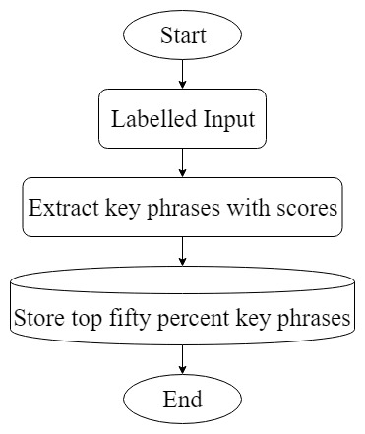
Proposed Model
Topic based key phrase list preparation

Slide 25
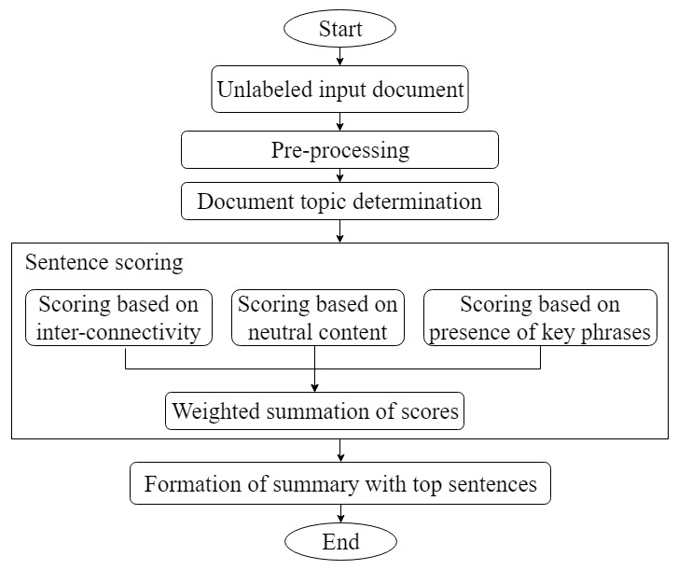
Proposed Model
Text Summarization execution

Slide 26
Proposed Model Implementation phases
Key phrase extraction
Steps:
Splitting document sequences of contiguous words
Calculating the “score” of each individual word
For each candidate keyword, addition the word scores of its constituent words

Slide 27
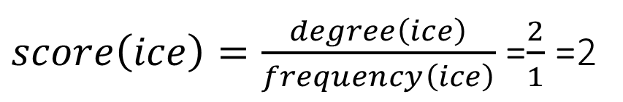
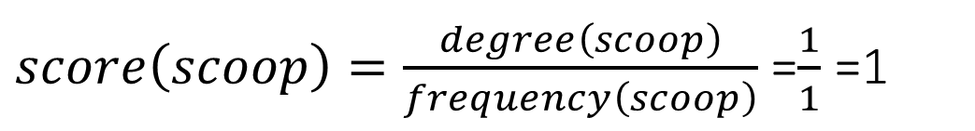
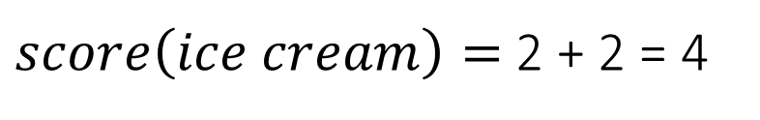
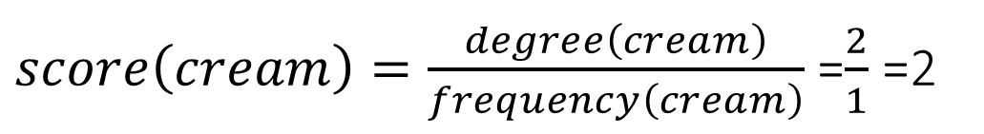
Proposed Model Implementation phases(Contd.)
Key phrase extraction Example:
Sentence : “A scoop of ice cream”
[ “A” , “scoop”, “of” , “ice”, “cream”]
[ “A” , “scoop”, “of” , “ice”, “cream”]
[ “scoop” , “ice”, “cream” ]
$score\left(scoop\right)=\frac{degree\left(scoop\right)}{frequency\left(scoop\right)}$ =$\frac{1}{1}$ =1
$score\left(ice\right)=\frac{degree\left(ice\right)}{frequency\left(ice\right)}$ =$\frac{2}{1}$ =2
$score\left(cream\right)=\frac{degree\left(cream\right)}{frequency\left(cream\right)}$ =$\frac{2}{1}$ =2
$score\left(ice cream\right)=$2 + 2 = 4

Slide 28
Proposed Model Implementation phases(Contd.)
Pre processing
Heading and body separation
Stop words removal
Lemmatization
Topic determination
Extract key words
Find out which type of key phrases exist most using previously prepared topic based list

Slide 29

Proposed Model Implementation phases(Contd.)
Suppose, four sentences: S1, S2, S3, S4
Polarity value (S1) = + 0.25
Polarity value (S2) = 0
Polarity value (S3) = - 0.25
Polarity value (S4) = 0
Length(S2) = L1
Length(S4) = L2 L2 < L1 : prioritize S4
Scoring of sentence
Scoring based on neutral content
Finding out polarity value
Calculate score as $\frac{1}{2 ×sentence length}$

Slide 30
Proposed Model Implementation phases(Contd.)
Scoring of sentence
Scoring based on sentence inter connectivity
Graph representation of text
Sentences as nodes
Calculate edge weight as cosine similarity of nodes
PageRank application

Slide 31
Proposed Model Implementation phases(Contd.)
cosine similarity (s1,s2)
cosine similarity (s2,s5)
S1
S2
S5
S4
cosine similarity (s1,s3)
cosine similarity (s4,s6)
S6
S3
Value of cosine similarity should be more than 0 to form edge between two nodes

Slide 32
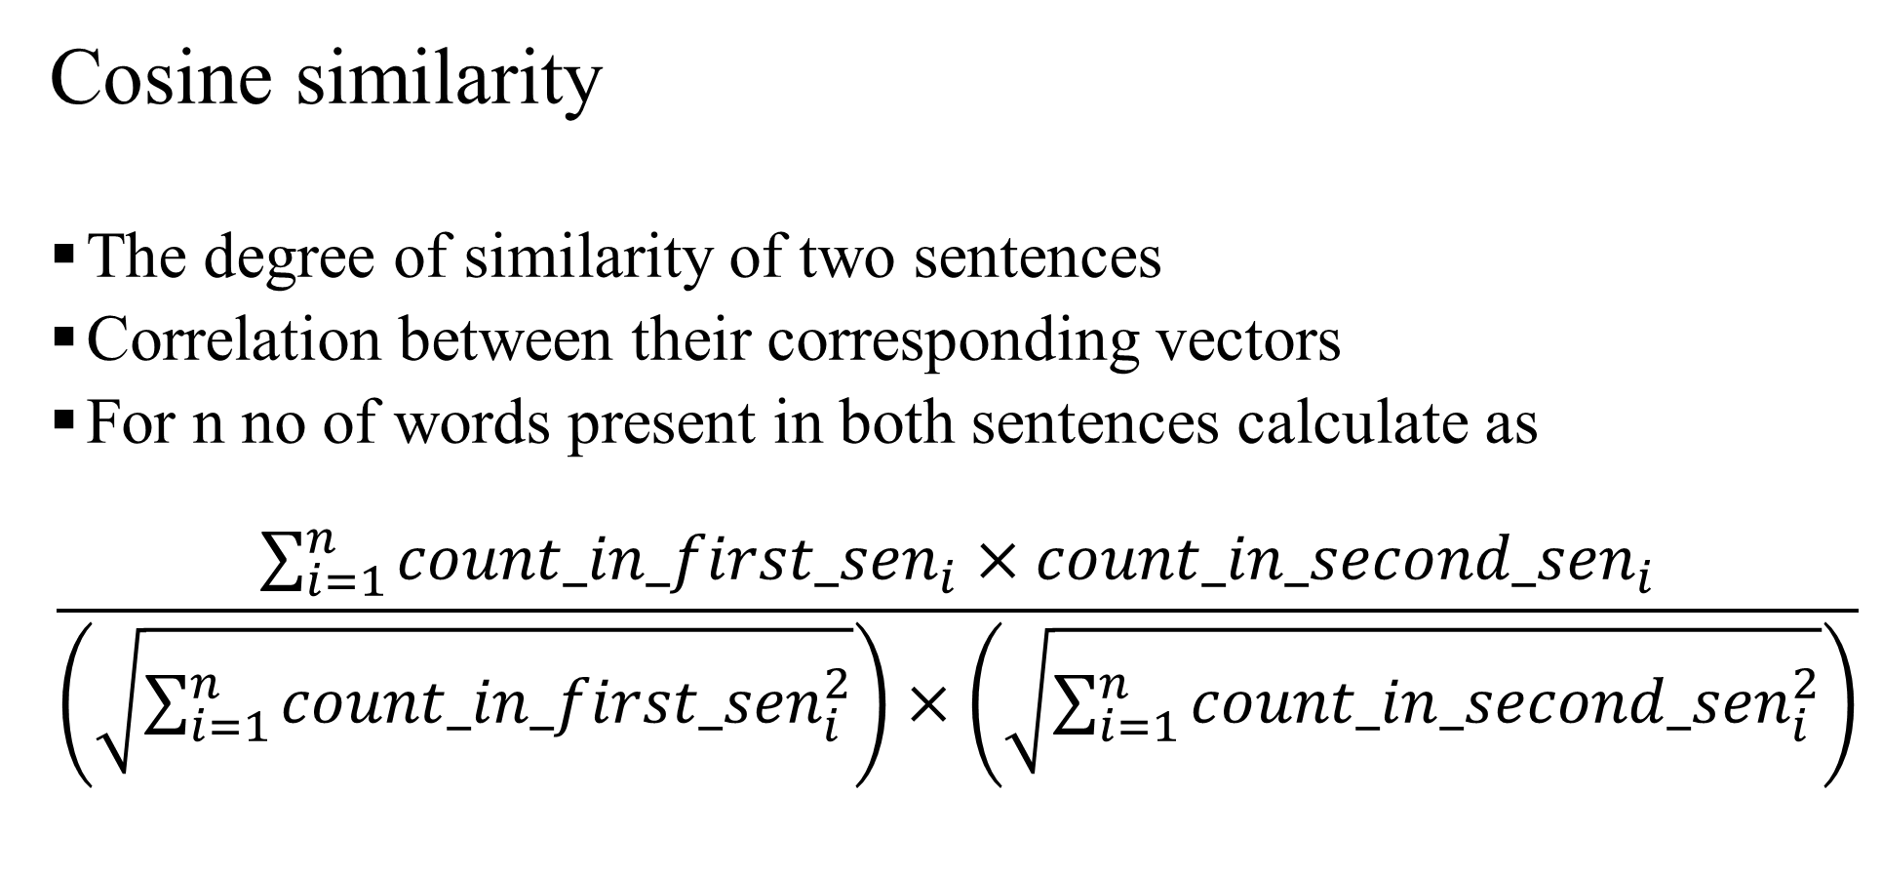
Proposed Model Implementation phases(Contd.)
Cosine similarity
The degree of similarity of two sentences
Correlation between their corresponding vectors
For n no of words present in both sentences calculate as
$$\frac{\sum_{i=1}^{n}{{count_in_first_sen}_{i}×{count_in_second_sen}_{i}}}{\left(\sqrt{\sum_{i=1}^{n}{{count_in_first_sen}_{i}^{2}}}\right)×\left(\sqrt{\sum_{i=1}^{n}{{count_in_second_sen}_{i}^{2}}}\right)}$$

Slide 33
Proposed Model Implementation phases(Contd.)
Edge weight (s1,s2)
Edge weight (s2,s5)
S1
S2
PageRank
Iterative process
Random weight to each node
Update node weight
Until difference of consecutive node weight is less than 0.0001
S5
S4
Edge weight (s1,s3)
Edge weight (s4,s6)
S6
S3

Slide 34
Proposed Model Implementation phases(Contd.)
Edge weight (s1,s2)
Edge weight (s2,s5)
S1
S2
S5
S4
Edge weight (s1,s3)
Edge weight (s4,s6)
S6
S3

Slide 35
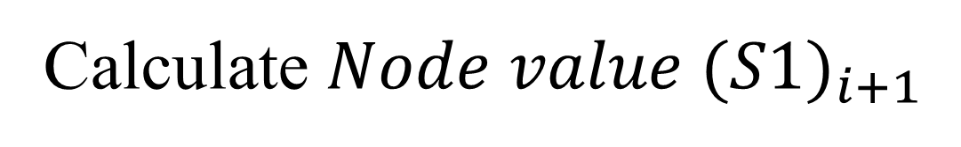
Proposed Model Implementation phases(Contd.)
Edge weight (s1,s2)
Edge weight (s2,s5)
S1
S2
S5
Edge weight (s1,s3)
Calculate ${Node value (S1)}_{i+1}$
S3

Slide 36

Proposed Model Implementation phases(Contd.)
Edge weight (s1,s2)
Edge weight (s2,s5)
S1
S2
S5
${Node value (S1)}_{i+1}$=
Edge weight (s1,s3)
$${Node value (S2)}_{i} ×\frac{Edge weight(S1,S2)}{Edge weight\left(S1,S2\right)+Edge weight(S2,S5)}$$
S3

Slide 37
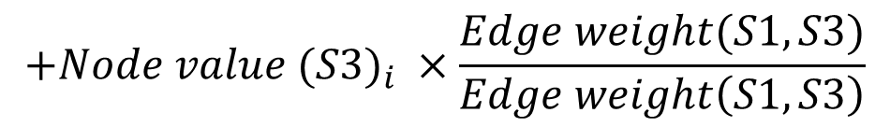
Proposed Model Implementation phases(Contd.)
Edge weight (s1,s2)
Edge weight (s2,s5)
S1
S2
S5
${Node value (S1)}_{i+1}$=
Edge weight (s1,s3)
$${Node value (S2)}_{i} ×\frac{Edge weight(S1,S2)}{Edge weight\left(S1,S2\right)+Edge weight(S2,S5)}$$
$${+Node value (S3)}_{i} ×\frac{Edge weight(S1,S3)}{Edge weight\left(S1,S3\right)}$$
S3

Slide 38
Proposed Model Implementation phases(Contd.)
Edge weight (s1,s2)
Edge weight (s2,s5)
S1
S2
S5
${Node value (S1)}_{i+1}$=
Edge weight (s1,s3)
$${Node value (S2)}_{i} ×\frac{Edge weight(S1,S2)}{Edge weight\left(S1,S2\right)+Edge weight(S2,S5)}$$
{
$${+Node value (S3)}_{i} ×\frac{Edge weight(S1,S3)}{Edge weight\left(S1,S3\right)}$$
S3
}
× 0.85 + 0.15

Slide 39
Proposed Model Implementation phases(Contd.)
Scoring based on the presence of key phrase
Count the number of key phrases of document type in sentence
Normalize with sentence length
Why normalize with sentence length ?
Sentence 1 : 12 key phrase
Sentence 2 : 10 key phrase
Sentence 1 : length: 40
Sentence 2 : length: 25
More significant: Sentence 1
❌ Sentence 2 ✔

Slide 40
Proposed Model Implementation phases(Contd.)
Combination of scores
Different weight for different scores
Formation of summary
Top forty percent of sentences
Maintain ordering of input document

Slide 41
Dataset
Experimental Verification
BBC New Summary
Five different topics of data
Document topics | Number of documents
Business | 510
Entertainment | 386
Politics | 417
Sport | 511
Tech | 401

Slide 42
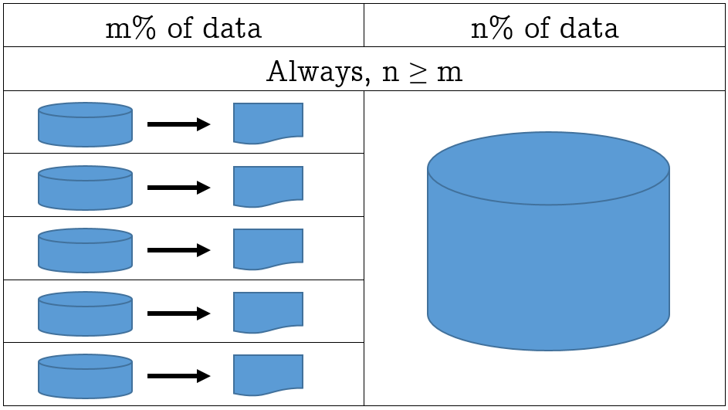
Use of dataset
Experimental Verification (Contd.)
Dataset
Portion 1
Portion 2

Slide 43
Dataset distribution in different set ups
Experimental Verification (Contd.)
Document Type | No of docs | 1st Set up |  | 2nd Set up |  | 3rd Set up
 |  | No of Doc for key phrase | No of Doc for summary | No of Doc for key phrase | No of Doc for summary | No of Doc for key phrase | No of Doc for summary
Business | 510 | 170 | 340 | 204 | 306 | 255 | 255
Entertainment | 386 | 128 | 258 | 154 | 232 | 193 | 193
Politics | 417 | 139 | 278 | 167 | 250 | 208 | 209
Sport | 511 | 170 | 341 | 204 | 307 | 255 | 256
Tech | 401 | 133 | 268 | 160 | 241 | 200 | 201

Slide 44
Confusion matrix of document topic determination in 1st set up
Experimental Verification (Contd.)
Types of documents | No of documents | No of documents determined as
 |  | Business | Entertainment | Politics | Sport | Tech
Business | 340 | 293 | 4 | 21 | 7 | 15
Entertainment | 258 | 23 | 170 | 19 | 30 | 16
Politics | 278 | 5 | 4 | 259 | 5 | 5
Sport | 341 | 37 | 7 | 14 | 265 | 8
Tech | 268 | 20 | 4 | 13 | 7 | 224

Slide 45
Confusion matrix of document topic determination in 2nd set up
Experimental Verification (Contd.)
Types of documents | No of documents | No of documents determined as
 |  | Business | Entertainment | Politics | Sport | Tech
Business | 306 | 270 | 4 | 17 | 6 | 9
Entertainment | 232 | 20 | 161 | 12 | 27 | 12
Politics | 250 | 6 | 1 | 235 | 6 | 2
Sport | 307 | 26 | 17 | 11 | 235 | 18
Tech | 214 | 12 | 1 | 8 | 4 | 216

Slide 46
Confusion matrix of document topic determination in 3rd set up
Experimental Verification (Contd.)
Types of documents | No of documents | No of documents determined as
 |  | Business | Entertainment | Politics | Sport | Tech
Business | 255 | 236 | 3 | 8 | 4 | 4
Entertainment | 193 | 15 | 147 | 5 | 19 | 7
Politics | 209 | 7 | 1 | 196 | 4 | 1
Sport | 256 | 17 | 22 | 12 | 193 | 12
Tech | 201 | 10 | 4 | 5 | 5 | 177

Slide 47
Accuracy of document topic determination
Experimental Verification (Contd.)

Slide 48
Different Evaluation Measures
Experimental Verification (Contd.)
Evaluation Measures
Intrinsic
Extrinsic

Slide 49
Experimental Verification (Contd.)
Different Intrinsic Measures
Intrinsic Measures
Text Quality Evaluation
Content Evaluation
Grammatically
Non redundancy
Coherence and structure
Co selection
Content Based
Cosine similarity
Unit overlap
Longest common sequence
ROUGE
Precision
Recall
F-measure
MRR
MAP
Reference quality

Slide 50
Experimental Verification (Contd.)
Different Intrinsic Measures
Intrinsic Measures
Text Quality Evaluation
Content Evaluation
Grammatically
Non redundancy
Coherence and structure
Co selection
Content Based
Cosine similarity
Unit overlap
Longest common sequence
ROUGE
Precision
Recall
F measure
MRR
MAP
Reference quality

Slide 51
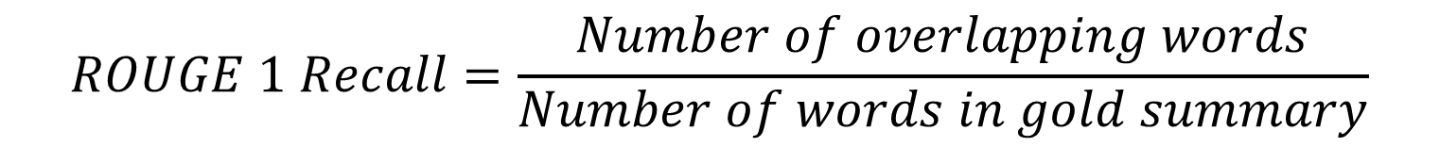
Used Evaluation Measure
Experimental Verification (Contd.)
ROUGE 1
Precision
Recall
F-score
$$ROUGE 1 Precision=\frac{Number of overlapping words}{Number of words in generated summary}$$
$$ROUGE 1 Recall=\frac{Number of overlapping words}{Number of words in gold summary}$$

Slide 52
Implementation Evaluation
Experimental Verification (Contd.)

Slide 53
Implementation Evaluation of different document types
Experimental Verification (Contd.)

Slide 54
Experimental Verification (Contd.)
Comparison of summaries
Compared with
Gensim
summarizer 0.0.7
TextSummarization – Online summarizer

Slide 55
Experimental Verification (Contd.)

Slide 56
Experimental Verification (Contd.)

Slide 57
Experimental Verification (Contd.)

Slide 58
Limitations
Used similarity function
Workable input formats
Dependency on other research problems
Unexplored research problems

Slide 59
Future Research Direction
Multi document summarization
Testing on more datasets

Slide 60
References
Narendra Andhale, L.A.Bewoor, “An Overview of Text Summarization Techniques”, in proceedings of 2016 International Conference on Computing Communication Control and automation (ICCUBEA), pp. 1-7, August, 2016, Pune, India.
Eduard Hovy, “Text Summarization”, in Ruslan Mitov, editor, The Oxford Handbook of Computational Linguistics (1 ed.), Chapter 32, pp. 583 - 598, 2003, Oxford University Press, Oxford, United Kingdom.
S.V.S.S Lakshmi, K.S. Deepthi, C. Suresh, “Text Summarization Basing on Font and Cue-Phrase Feature for a Single Document”, in proceedings of the 49th Annual Convention of the Computer Society of India CSI, Volume 2, pp. 537-542, December, 2014, Hyderabad, Telangana, India.
Noopur Srivastava and Bineet Kumar Gupta, “An Algorithm for Summarization of Paragraph Upto One Third with the Help of Cue Words Comparison”, International Journal of Computer Science and Applications, Volume 5, No. 5, pp. 167-171, 2014, United Kingdom.
Md. Iftekharul Alam Efat, Mohammad Ibrahim and Humayun Kayesh , “Automated Bangla Text Summarization by Sentence Scoring and Ranking”, in proceedings of 2013 International Conference on Informatics, Electronics and Vision (ICIEV), pp. 1-5, May, 2013, Dhaka, Bangladesh.
R.V.V. Murali Krishna and Ch. Satyananda Reddy, “A Sentence Scoring Method for Extractive Text Summarization based on Natural Language Queries”, International Journal of Computer Science Issues, Vol. 9, Issue 3, No 1, pp. 259-262, May, 2012.
Hongyan Jing, “Sentence Reduction for Automatic Text Summarization”, in proceedings of the Sixth conference on Applied natural language processing, pp. 310- 315, May, 2000, Seattle, Washington, USA.
“Benton Foundation”, http://www.benton.org, Last accessed date: 25 July 2018.

Slide 61
References(Contd.)
Esaú Villatoro Tello, Luis Villaseñor Pineda and Manuel Montesy Gómez, “Using Word Sequences for Text Summarization”, in proceedings of 9th International Conference of Text, Speech and Dialogue, pp. 293-300, September, 2006, Brno, Czech Republic.
Rushdi Shams et al., “Corpus-based Web Document Summarization using, Statistical and Linguistic Approach”, in the proceedings of 2010 International Conference on Computer and Communication Engineering (ICCCE), May, 2010, Kuala Lumpur, Malaysia.
Joel Larocca Neto, Alex A. Freitas, and Celso A. A. Kaestner, “Automatic Text Summarization Using a Machine Learning Approach”, in proceedings of the 16th Brazilian Symposium on Artificial Intelligence: Advances in Artificial Intelligence, pp. 205-215, November, 2002, Porto de Galinhas, Recife, Brazil.
Kam – Fai Wong, Mingli Wu and Wenjie Li, “Extractive Summarization Using Supervised and Semi-Supervised Learning”, in the proceedings of the 22nd International Conference on Computational Linguistics, pp. 985 – 992, August, 2008, Manchester, United Kingdom.
Ansamma John, Dr M Wilscy, “Random Forest Classifier Based Multi-Document Summarization System”, in the proceedings of 2013 IEEE Recent Advances in Intelligent Computational Systems (RAICS), pp. 31-36, December, 2013, Trivandrum, India.
Massih R. Amini, Nicolas Usunier and Patrick Gallinari, “Automatic Text Summarization Based on Word-Clusters and Ranking Algorithms”, in the proceedings of the 27th European conference on Advances in Information Retrieval Research, pp. 142-156, March,2005, Santiago de Compostela, Spain.

Slide 62
References(Contd.)
Rada Mihalcea and Paul Tarau, “TextRank: Bringing Order into Texts”, in the proceedings of Conference on Empirical Methods in Natural Language Processing (EMNLP), July, 2004, Barcelona, Spain.
Rada Mihalcea, “Graph based ranking algorithm for sentence extraction applied on text summarization”, in the proceedings of the ACL 2004 on Interactive poster and demonstration sessions, July, 2004, Stroudsburg, PA, USA.
Rafael Ferreira et al., “A Multi Document Summarization System Based on Statistics and Linguistic Treatment”, Expert Systems with Applications, Volume 41, Issue 13, pp. 5780-5787, October ,2014, United Kingdom.
Salil Dabholkar, Yuvraj Patadia and Prajyoti Dsilva, “Automatic Document Summarization using Sentiment Analysis”, in Proceedings of 2016 International Conference on Informatics and Analytics (ICIA), August, 2016, Pondicherry, India.
Solov’ev A.N., Antonova A.Ju. and Pazel’skaia A.G., “Using Sentiment-Analysis for Text Information Extraction”, in proceedings of the 2012 Computational Linguistics and Intelligent Technology, pp. 616-627, August, 2012, Moscow, Russia.
Josef Steinberger, Karel Jezek, “Evaluation Measures For Text Summarization”, Computing and Informatics, Vol. 28, pp. 1001–1026, March, 2009, Bratislava, Slovakia.
Sergey Brin and Lawrence Page, “The anatomy of a large-scale hyper-textual Web search engine”, in the proceedings of Seventh International World-Wide Web Conference (WWW 1998), pp. 107-117, April, 1998, Brisbane, Australia.

Slide 63
References(Contd.)
“The Python Package Index”, https://pypi.org/, Last accessed date: 8 October, 2018.
“Kaggle”, https://www.kaggle.com, Last accessed date: 8 October 2018.
“Insight Resources”, http://mlg.ucd.ie , Last accessed date: 8 October 2018.
D. Greene and P. Cunningham, “Practical Solutions to the Problem of Diagonal Dominance in Kernel Document Clustering”, in the proceedings of the 23rd International Conference on Machine Learning, pp. 377-384, June, 2006, Pittsburgh, Pennsylvania, USA.
Chin-Yew Lin, “ROUGE: A Package for Automatic Evaluation of summaries”, in proceedings of the Workshop on Text Summarization Branches Out (WAS 2004), January, 2004, Barcelona, Spain.
“genism: Topic Modelling for Humans”, https://radimrehurek.com/gensim/, Last accessed date: 8 October, 2018.
“TextSummarization”, https://textsummarization.net/, Last accessed date: 8 October, 2018.
“Mashape- Free API Management Platform & Marketplace”, https://market.mashape.com/ , Last accessed date: 8 October, 2018.

Slide 64
Thank You for Your Attention
Any question!

